Slide 1
Performance
Advanced Android Development
Lesson 4

Slide 2

4.1 Rendering and layout

Slide 3
Contents
Rendering basics
Minimize overdraw
Simplify complex view hierarchies
Debug GPU Overdraw tool
Layout Inspector tool
Systrace tool
dumpsys tool
Note: Profile GPU Rendering is covered in the 4.2 Performance slide deck

Slide 4
Rendering basics

Slide 5
Rendering and hardware
CPU computes display lists, graphics commands that define an output frame
GPU (graphics processing unit) renders to the display, lightens load on CPU for graphics-intensive apps
Memory stores images and data
Battery provides electrical power for hardware

Slide 6
Display list
Display list defines output image using primitives such as lines and basic shapes

Slide 7
Rendering pipeline
Rendering pipeline is a conceptual model that describes the steps for rendering graphical information on the screen
Creates display list from program instructions in CPU
Passes display list to GPU
GPU executes display list to draw screen

Slide 8
Hardware has constraints
Hardware is a major factor in performance.
Stressing or exceeding hardware constraints can
cause apps to be slow
cause bad display performance
exhaust battery

Slide 9
Measure, layout, invalidation
To display views, Android system traverses view hierarchy, determining sizes (measuring) and positions (layouts) for all views
May require multiple passes through view hierarchy
Calling invalidate() informs system that views have changed and need recalculation and redrawing
… (It's more complex, but this is what you need to know)

Slide 10
Minimize overdraw

Slide 11
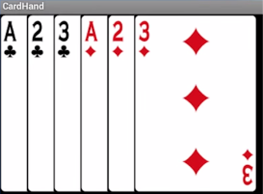
What is overdraw?
Overdraw is drawing the same opaque pixel more than once
For example, drawing whole overlapping cards on top of each other

Slide 12
Overdraw hurts performance
Wastes rendering time by drawing invisible pixels…
…which also wastes hardware resources
Can result in slow rendering and stuttering
Especially on less powerful devices
Android system optimizes drawing, however...
… if you override onDraw(), you become responsible

Slide 13
Remove unnecessary backgrounds
Remove covered or invisible backgrounds:
<ImageView
android:layout_width="match_parent"
android:layout_height="match_parent"
android:src="@drawable/beach"
android:background="@android:color/white" />

Slide 14

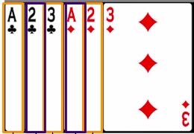
Clip custom views
Only draw visible portions of view or shape
Clipping also takes time ⇒ trade-offs

Slide 15
Functions for clipping
canvas.clipRect—defines a clipping rectangle. Only what's inside the rectangle is drawn
canvas.quickReject—determines if the content to be drawn is inside a clipped region. If it is, you can skip it and save processing time for complex drawings.
See the The Canvas class for more on clipping

Slide 16
Reduce transparency
Alpha rendering is the process of combining an image with a background to create the appearance of partial or full transparency
Fade-outs, drop shadows, transparent animations use alpha rendering. Use carefully and consider alternative designs

Slide 17
Draw the right shape!
Consider how to compose a screen to minimize overlap
Correct drawing is much cheaper than clipping

Slide 18
Debug GPU Overdraw tool

Slide 19
Disable Instant Run for profiling
Small performance cost of Instant Run can skew tool data.
In Android Studio:
Windows or Linux: File > Settings Mac OSX: Android Studio > Preferences
Go to Build, Execution, Deployment > Instant Run
Deselect Restart activity on code changes

Slide 20
Starting Debug GPU Overdraw tool
On device:
Settings > Developer options
Scroll to Hardware accelerated rendering section
Select Debug GPU Overdraw
Select Show overdraw areas
Colors appear in the UI/layouts on your device

Slide 21
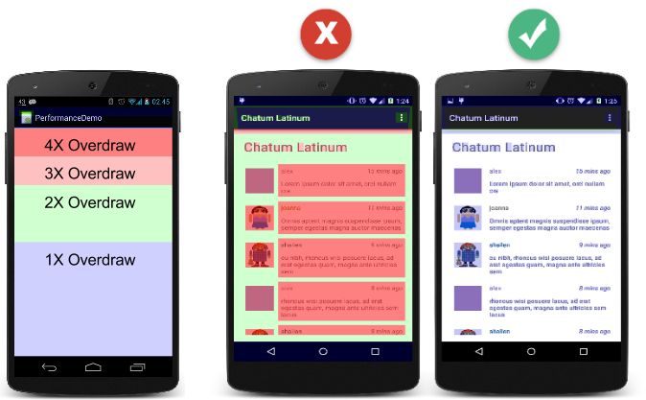
Colors and their meanings
True color: no overdraw
Purple/blue: overdrawn once
Green: twice
Pink: three times
Red: four or more times

Slide 22
Bad and good results

Slide 23
Simplify complex view hierarchies

Slide 24
Complex view hierarchies
Complex view hierarchies
Deep with many nested views and view groups
Have large numbers of views
Have overlapping views

Slide 25
Use ConstraintLayout
Build a Responsive UI with ConstraintLayout
Flattens view hierarchy
Optimized by Android system

Slide 26
Remove views
Remove views that are
completely covered
never displayed
outside screen

Slide 27
Combine views
Combine views
Use fewer fonts and styles and combine TextViews
Combining views may affect how you present information
Consider design trade-offs
Prioritize simplicity

Slide 28
Exponential layout passes
Some layout containers and their children require two layout passes to finalize positions of child views
When you nest them, the number of layout passes increases exponentially with each level of the hierarchy

Slide 29
Watch out for layout passes...
… when some types of views
are at the root of a complex view hierarchy
are the parent of a deep subtree
occur many times in your layout

Slide 30
Watch out for layout passes with...
RelativeLayout
LinearLayout that uses measureWithLargestChild
GridView that uses gravity
Custom view groups that are subclasses of the above
Weights in LinearLayout (sometimes)

Slide 31
Layout Inspector tool

Slide 32
Layout Inspector tool
Use Layout Inspector to inspect view hierarchy at runtime
Especially when your layout is built at runtime, not XML
Creates static snapshot of view hierarchy at given time

Slide 33
Starting Layout Inspector tool
Run app
Tools > Android > Layout Inspector in Android Studio
Choose app process to attach to (such as com.example.android.stackedview)

Slide 34
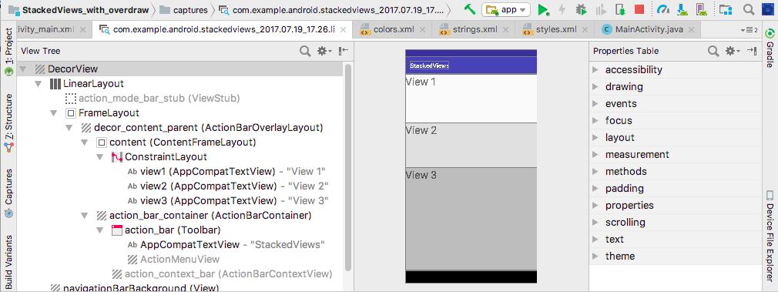
Layout Inspector basics
Selected view
properties
View hierarchy
Device display

Slide 35
Lint tool

Slide 36
Lint tool
Use Lint tool on layout files to find view hierarchy optimizations
Runs automatically whenever you compile your program
Choose Analyze > Inspect Code… to manually run lint on your whole project, or on a particular module or file

Slide 37
Lint tool example inspection message
"Node can be replaced by TextView with compound drawables
A LinearLayout that contains an ImageView and a TextView can be more efficiently handled as a compound drawable.
Add a Drawable to a TextView using one of the setCompoundDrawables methods, and specify how text flows around the drawable."

Slide 38
Systrace tool

Slide 39
Systrace tool
Built into Android SDK
Captures and displays execution times of app and Android system processes
Combines data from Android kernel, such as CPU scheduler, disk activity, and application threads to generate HTML report

Slide 40
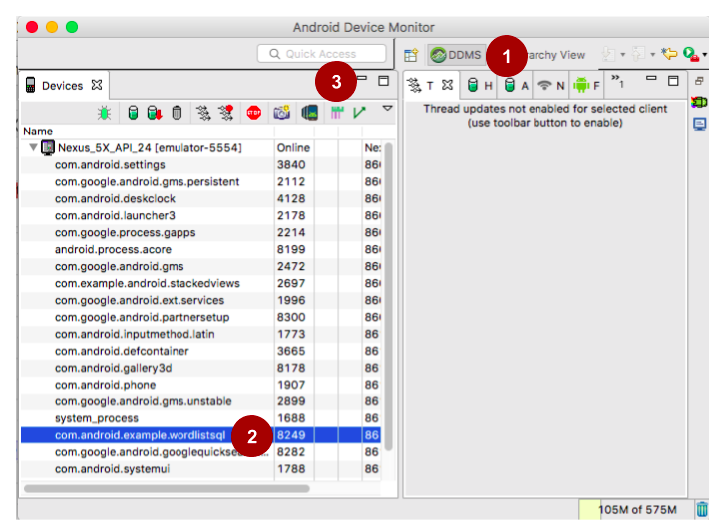

Starting Systrace from Android Studio
Tools > Android > Android Device Monitor
Click DDMS (1)
Choose package (2)
Click Systrace (3)

Slide 41
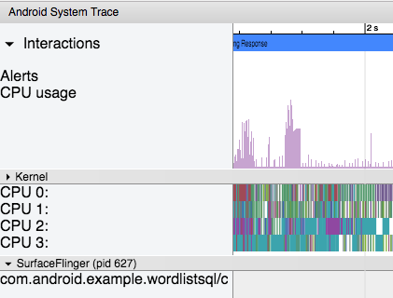
Systrace output
Open trace.html file in Chrome
See Systrace practical...

Slide 42
dumpsys tool

Slide 43
dumpsys command line tool
dumpsys runs on device and dumps status information about system services. Get information about frames:
adb shell dumpsys gfxinfo <PACKAGE_NAME>
adb shell dumpsys gfxinfo \ com.example.android.largeimages
shell dumpsys gfxinfo \ com.example.android.largeimages framestats (6.0+ only)

Slide 44
What's next?
Concept chapter: 4.1 Rendering and Layout
Practicals:
4.1A Using the Profile GPU Rendering tool
4.1B Using the Debug GPU Overdraw and Layout Inspector tools
4.1C Using the Systrace and dumpsys tools

Slide 45
END

